Slide 1

W E L C O M E
BEFORE WE BEGIN..
PLEASE NOTE THAT THE INTERVIEW ANSWERS BY THE SPECIAL GUEST ARE NOT ACTUALLY QUOTED BY THE GUEST. THEY ARE FICTIONAL AND ONLY MADE AS SUCH TO PLAY INTO THE “TV SHOW/INTERVIEW” PRESENTATION FORMAT. ALL THE INFORMATION, HOWEVER, HAS BEEN RESEARCHED WITH REFERENCES CITED IN A SEPARATE DOCUMENT. THANK YOU.

Slide 2

WORLD OF IT GREATS
C H E R I S H B R O W N E
HOST

Slide 3

Steve jobs
IT GREAT:

Slide 4
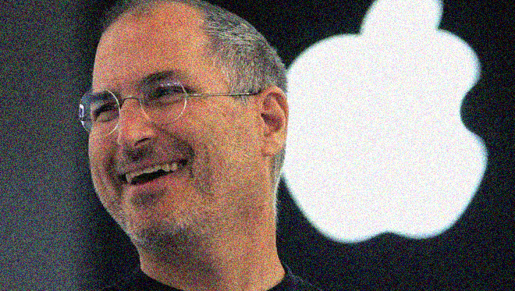
About our special guest
Steve Jobs was born on February 24, 1955. As one of the founders of Apple Computer he changed technology, bringing us the first home computers, smart phone, and tablet computers.

Slide 5

Career highlights, challenges and path to sucess

Slide 6

Timeline
1968 – At 13 years old Steve Jobs got his first job at Hewlett-Packard (HP)
1969 – At 14 he met Steve Wozniak who was five years older than him
1972 – Jobs and Wozniak built and sold illegal blue boxes that allowed users to make phone calls for free
1973 – Jobs went to Reed College but dropped out after one semester, afterwards he takes a job at Atari
1976 – Jobs and Wozniak show case the first board for the Apple I at the Homebrew Computer Club. Wozniak, Jobs and Ron Wayne establish and operate as Apple Computer
1977 – Apple Computer is growing, they showcase Apple II at the West Coast Computer Fair
1980 – Apple goes public and enters the stock market making Steve Jobs wealthy.
1984 – Macintosh introduced
1985 – Jobs leaves Apple and founds NeXT
1986 – Purchased the computer animation division of George Lucas’ ILM and incorporates it into Pixar
1989 – Jobs was named entrepreneur of the decade by Inc. Magazine as NeXT and Pixar grew.

Slide 7

Timeline cont’d
1991 – Pixar goes public and makes Jobs a billionaire
1996 – Apple purchases the NeXT operating system and brings back Jobs as an advisor. He becomes CEO again in 1997
2001 – Apple now successful releases the first iPod, Jobs didn’t have any idea how much it would change technology or the company
2003 – Diagnosed with pancreatic cancer and refused traditional medical treatments. Opted for surgery in 2004
2007 – Jobs introduced the iPhone, the most associated item with Apple today. iPhone 3G released the following year in 2008
2008 – Jobs takes medical leave and receives a liver transplant
2010 – Jobs announces release of first tablet, the iPad, and a new improved iPhone (iPhone 4)
2011, August – Jobs’ health worsens, he resigns from Apple, leaving Tim Cook in charge
2011, October – Steve Jobs passed away at home surrounded by his family

Slide 8

First interviewer
ANTOINE ASANGA,
COMPUTER LIFE DIGEST

Slide 9

What three words would your colleagues use to describe you?
ANTOINE :
Hello Steve, I am Antoine from Computer World Digest and I would like to know.

Slide 10
STEVE JOBS:
Passionate; I have a lot of passion in what I do, I never give up, if you don't love what you do or have fun doing it then it's obvious you might or have to give up at some point. In the society today ''Successful'' people love what they do because they can perceiver when it gets tough and people who don't love what they do will quite when it becomes challenging. If you don't love what you do then you must fail. You need to have passion for what you do.

Slide 11

Steve jobs:
Visionary; I will also say visionary because without a strong vision, Apple would not be where it is today. It would be hard to become a successful person or leader without a clear vision for your company /organization or where/what you want to be in the years ahead.

Slide 12
STEVE JOBS:
Hard Work ; I will also say I am a very hard-working person. ''Your work is going to fill a large part of your life, and the only way to be truly satisfied is to do what you believe is great work, and the only way to do great work is to love what you do. If you haven’t found it yet, keep looking. Don’t settle. As with all matters of the heart, you’ll know when you find it. And, like any great relationship, it just gets better and better as the years roll on. So keep looking until you find it. Don’t settle."
Thank you, Steve, I will pass you on to the next Interviewer

Slide 13
second interviewer
JAMIE LU,
IT WORLD MAGAZINE

Slide 14

What WAs the biggest challenge you have faced and how did you handle it?
JAMIE:

Slide 15
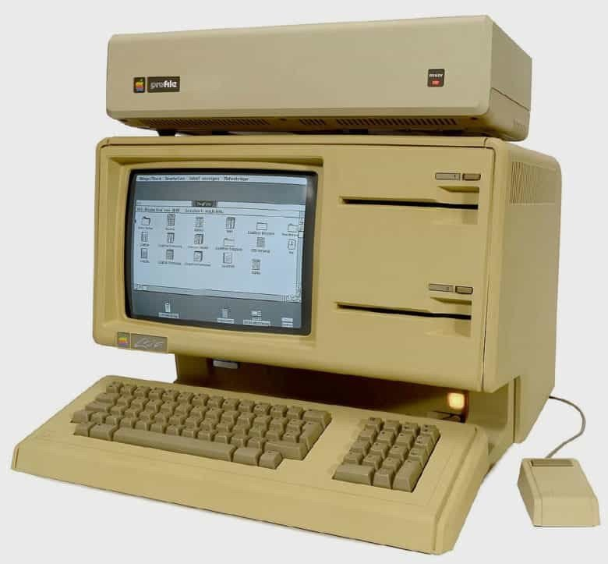
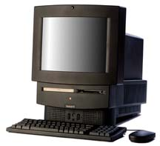
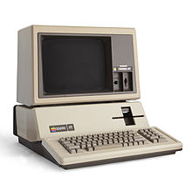
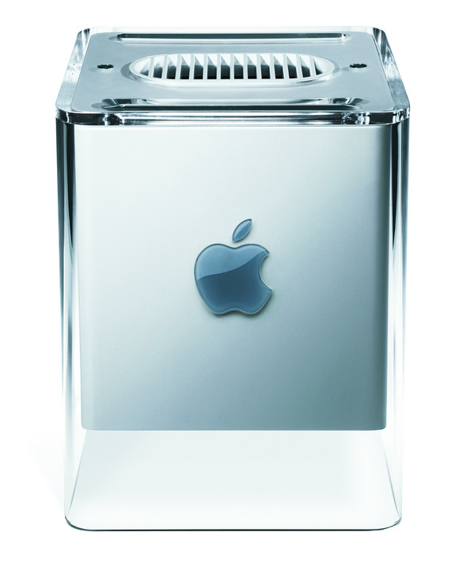
STEVE JOBS:
“I have faced many challenges throughout my career in the IT industry. Maybe it was when I thought that NeXT computer was a success, or the numerous product failures I have launched, like the Apple Lisa, Macintosh TV, Apple III, or the Powermac g4 cube.“

Slide 16
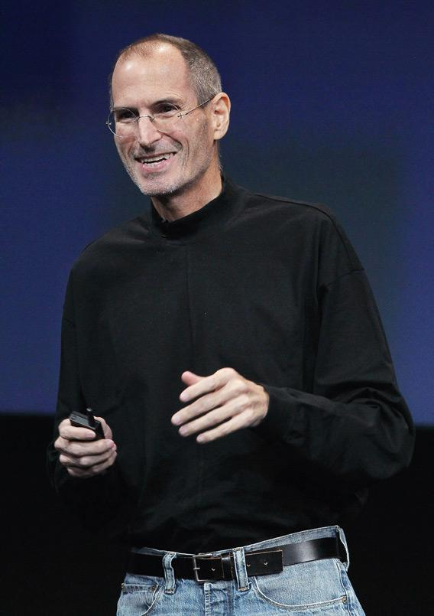
Steve jobs:
“The biggest challenge I have ever faced was when I was fired from the company I co-founded and put hard work into. I was 30 years old and it was so sudden. It was devastating and I felt like a very public failure. With some reflection, I realized that getting fired from Apple turned out to be the best thing that could have ever happened to me… It freed me to enter one of the most creative periods of my life… It was awful tasting medicine, but I guess the patient needed it.”

Slide 17

Wow! so the biggest challenge you have faced led you to your biggest opportunity?
JAMIE:

Slide 18
Steve jobs:
“Yes! Once I decided what I really wanted to do, I had the inspiration to turn what at the time was a tiny, struggling computer company into The most valuable corporation on the planet.”

Slide 19

how did you achieve that?
JAMIE:

Slide 20
Steve jobs:
“Sometimes life hits you in the head with a brick. Don’t lose faith. I’m convinced that the only thing that kept me going was that I loved what I did. You’ve got to find what you love… If you haven’t found it yet, keep looking. Don’t settle.”

Slide 21
LAST interviewer
MAHER ALHELWANI,
TECHMANIA TV

Slide 22
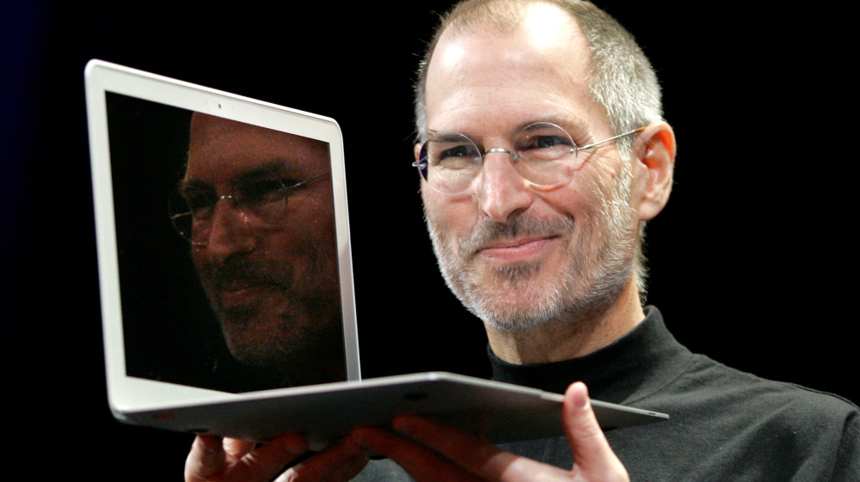
Give an example of where you have applied your technical knowledge in a practical way.
Maher:

Slide 23

StEve Jobs
“In 1997, Apple ran into many problems. These problems contributed to large financial losses. Apple's board of directors offered me to contribute to finding solutions to these problems. They offered me to come back as a consultant for the company. They did not offer it because I am Steve Jobs. It is because they know my skill as a leader.
In 1998, I was appointed company leader again. In 1998, the iMac was introduced. The device was successful and in demand from customers. My success in launching this device is due to my leader skills”.

Slide 24

StEve Jobs:
“Among the most important factors fundamental to my success:
1. I have a vision It will be difficult to become a successful leader without a clear vision for your company or organization. Just being able to start your Startup is not enough. You must be able to continuously plan for the long term. Without a clear vision, Apple could not be able to succeed as it is today.
2. Passion development I had both the passion and the self-confidence to turn my dream into reality. You have to love what you do. Developing a strong passion for your business helps you on the path to business success”.

Slide 25

STEVE JOBS:
“3. Challenge the limits of your employees
I always try to find the actual capabilities of my staff. Leadership is not about arranging people or micromanaging. You need to encourage employees to challenge themselves to innovate and increase productivity
4. Follow excellence, not money
I did not limit my efforts to make huge money from my ideas. I was very focused on creating exciting and unique innovations. Instead of just focusing on making money, you should focus on providing quality services and products. This is essential to help transform your Startup into a recognizable brand.
5. Don't aim without perfection
I have not compromised on perfection. Before launching the iPod, I went to completely replace the headphone jacks. This is a clear example that I will not settle for less”.

Slide 26

THANK YOU
WORLD OF IT GREATS
CHERISH BROWNE
ANTOINE ASANGA
JAMIE LU
MAHER ALHELWANI

